Slide 1

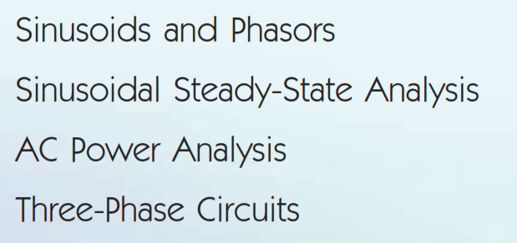
Outline

Slide 2

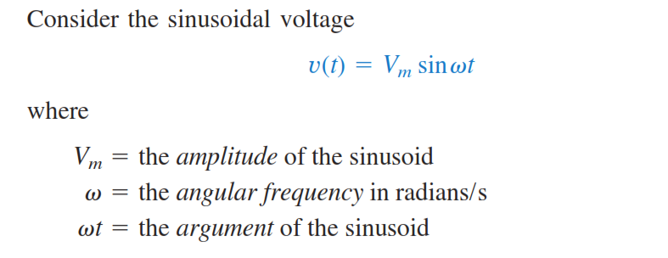
Cont..

Slide 3
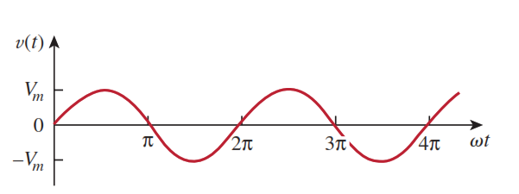
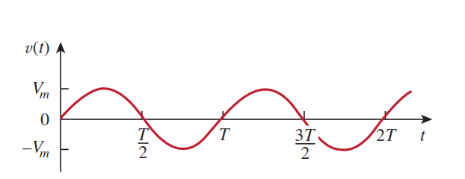
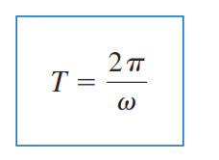
Cont..

Slide 4
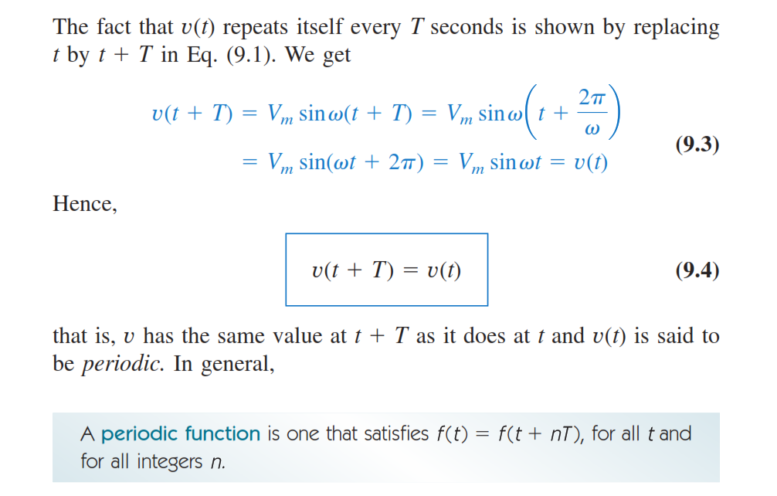
Cont..

Slide 5
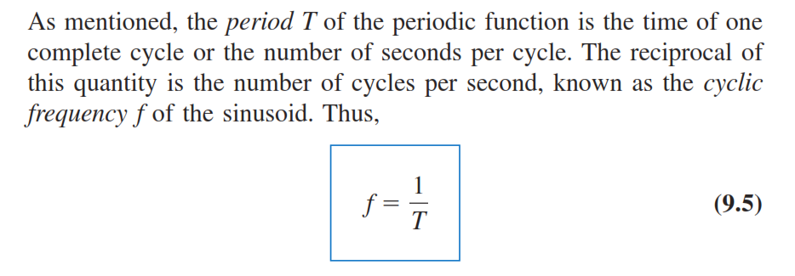

Cont..

Slide 6
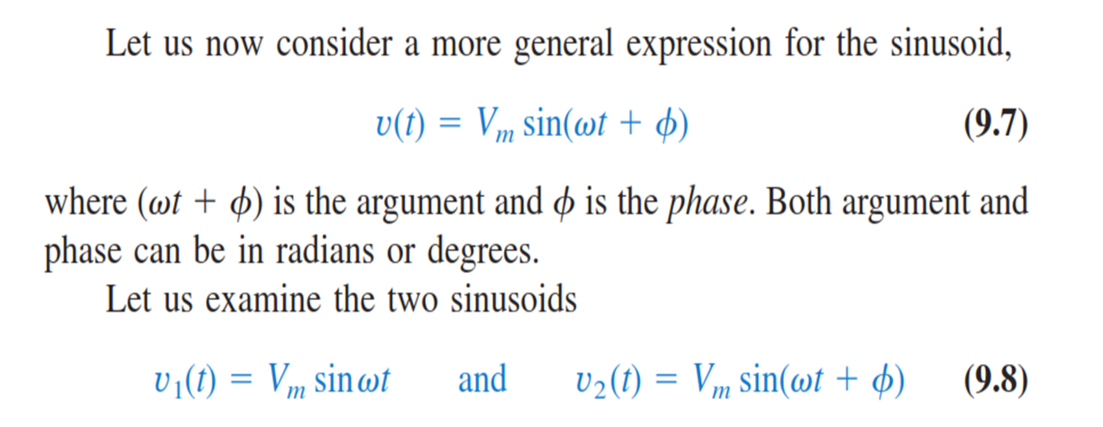
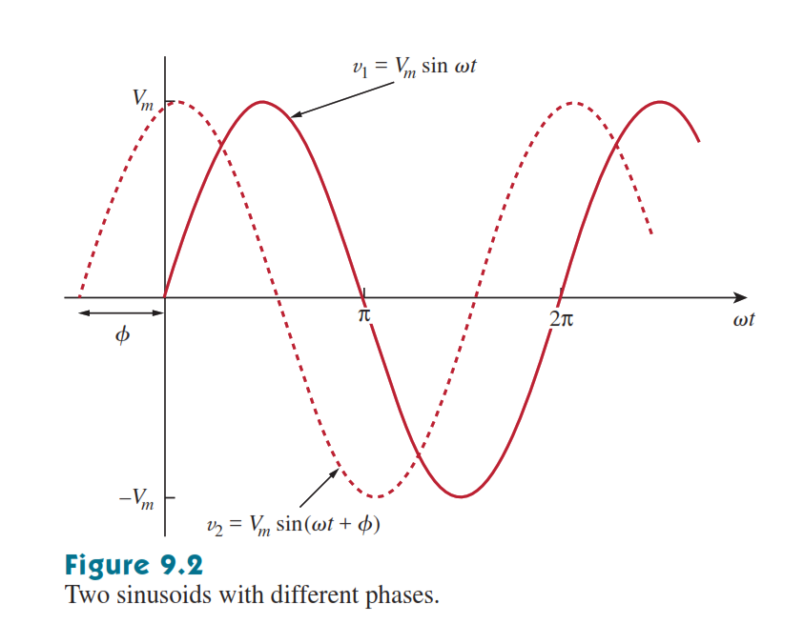
Cont..

Slide 7

Cont..

Slide 8
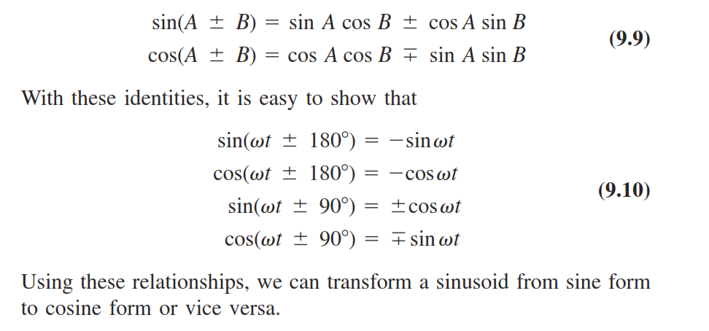
Cont..
A sinusoid can be expressed in either sine or cosine form. When
comparing two sinusoids, it is expedient to express both as either sine
or cosine with positive amplitudes. This is achieved by using the trigonometric identities

Slide 9

Example 01.

Slide 10

Example 02

Slide 11
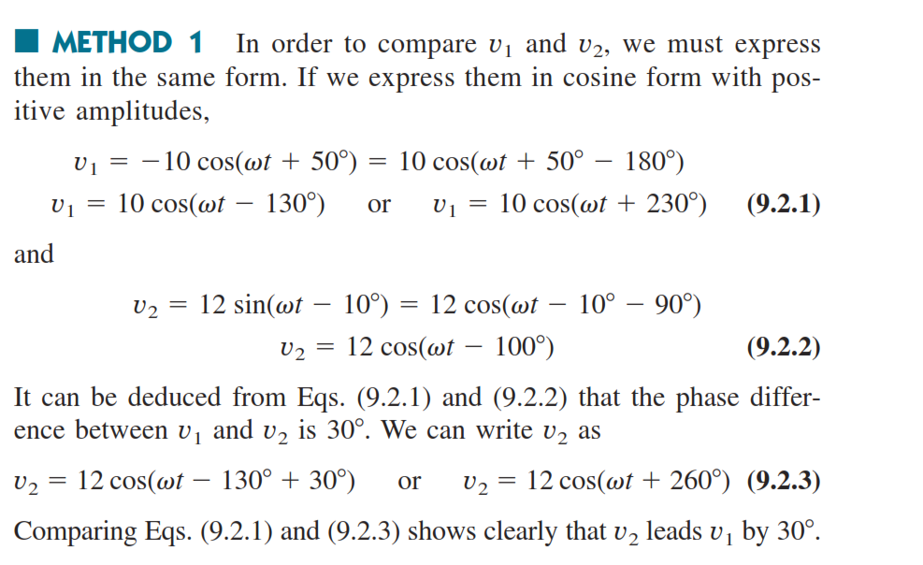
Cont..

Slide 12


Cont..

Slide 13

Home work

Slide 14

Phasors

Slide 15
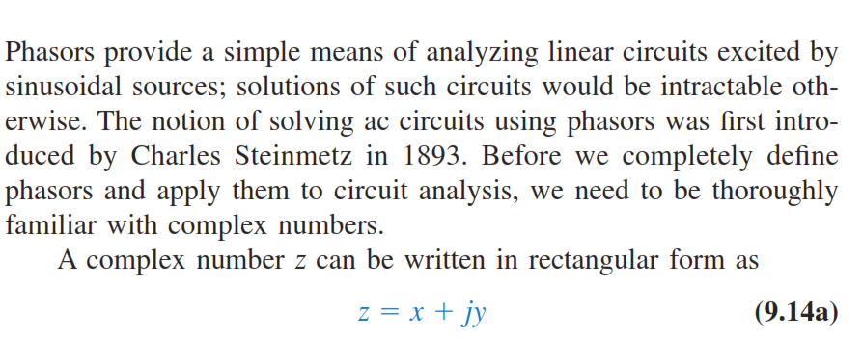
Cont..

Slide 16


Cont..

Slide 17
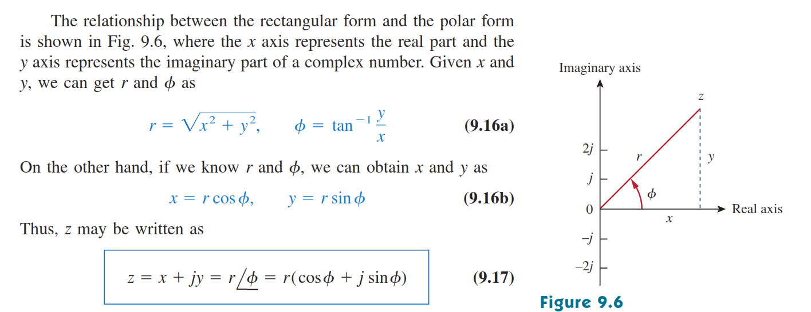
Cont..

Slide 18

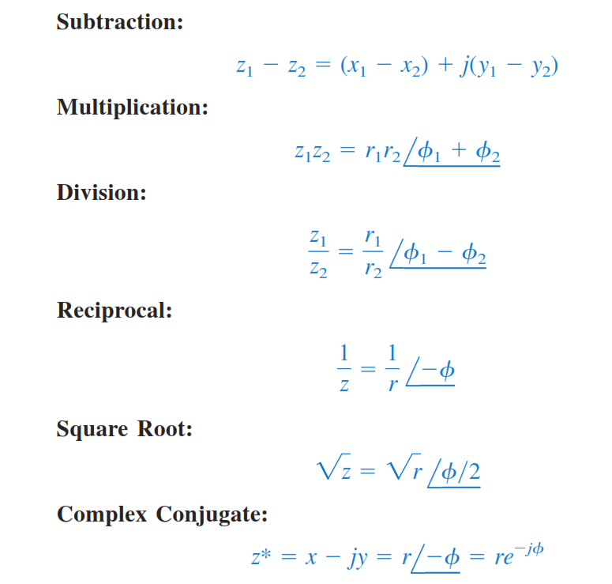

Slide 19
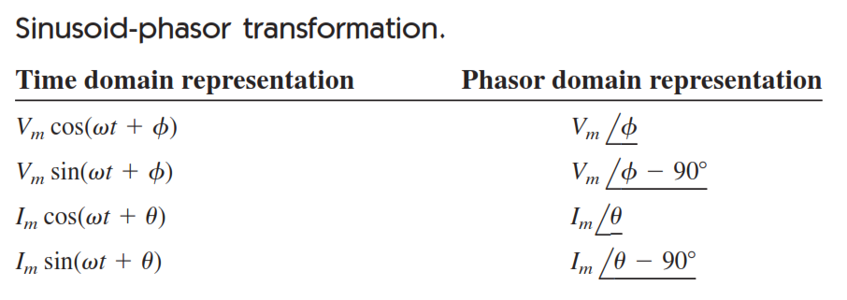
Cont..

Slide 20
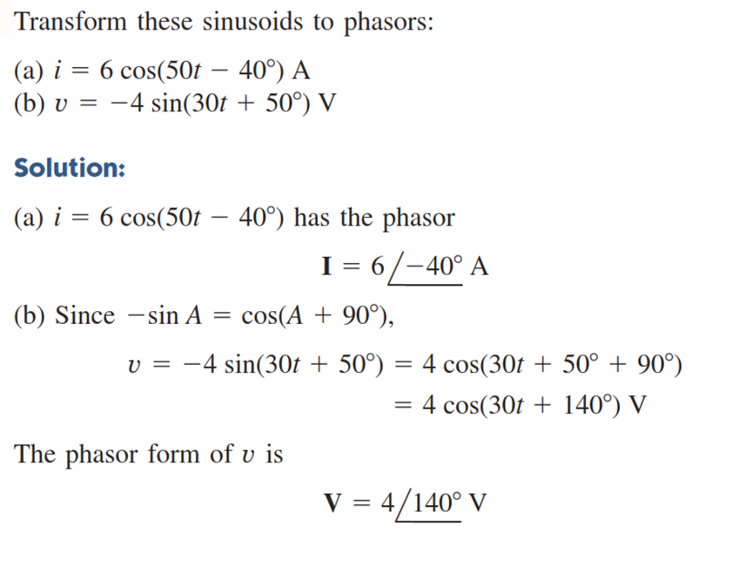
Example

Slide 21
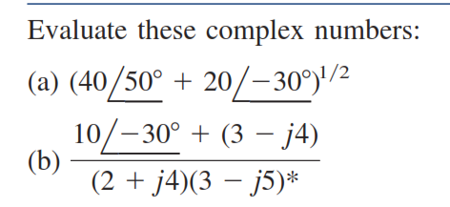
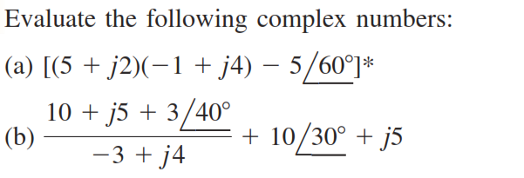
Home work

Slide 22

example

Slide 23

H/W

Slide 24
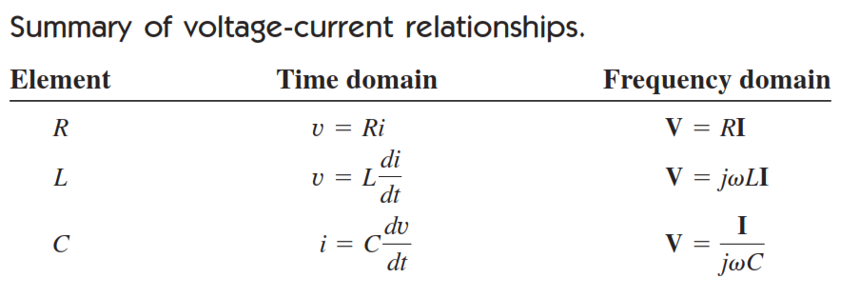
Phasor Relationships for Circuit Elements
Now that we know how to represent a voltage or current in the phasor or frequency domain, one may legitimately ask how we apply
This to circuits involving the passive elements
R,L, and C. What we need to do is to transform the voltage-current relationship from the time domain to the frequency domain for each element

Slide 25
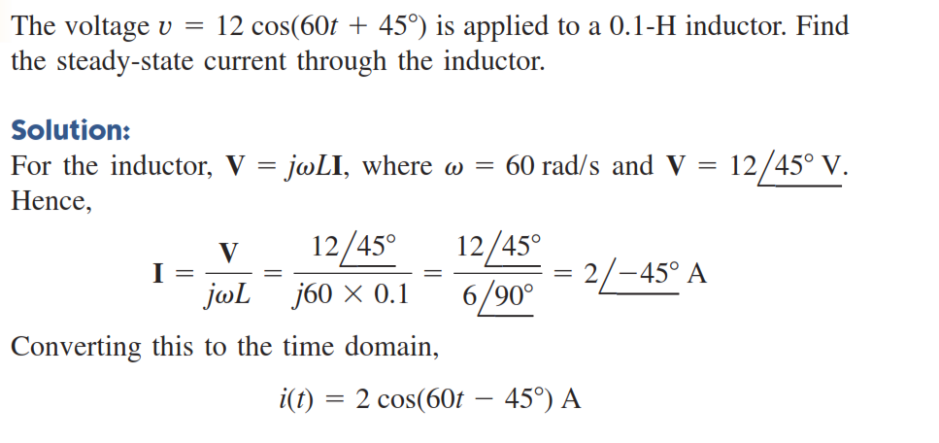

Slide 26

Example.

Slide 27
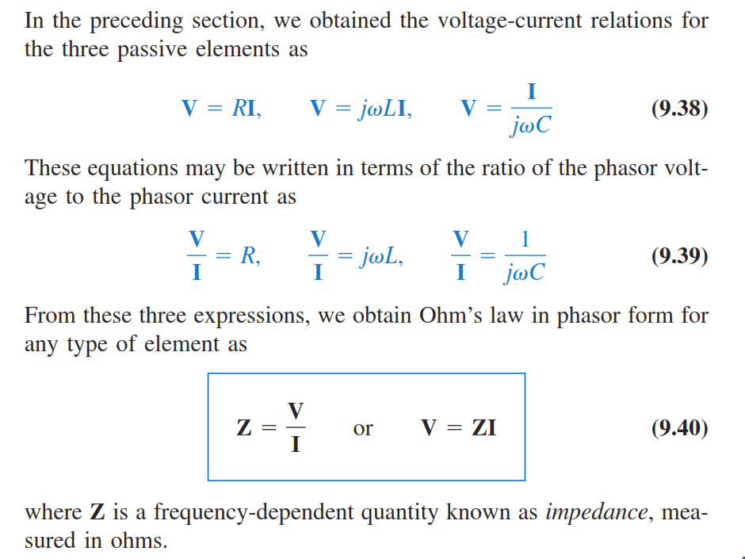
Impedance and Admittance

Slide 28

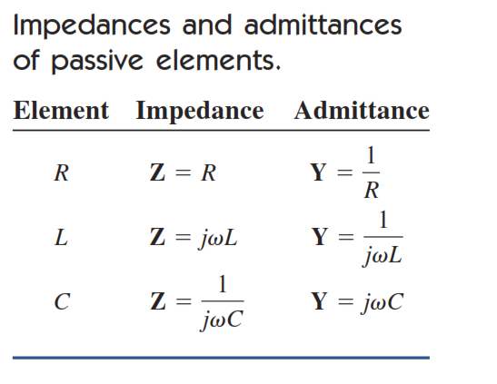

Slide 29
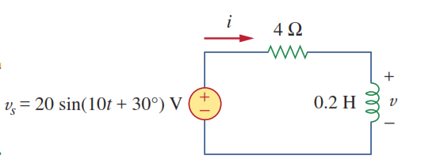


Slide 30

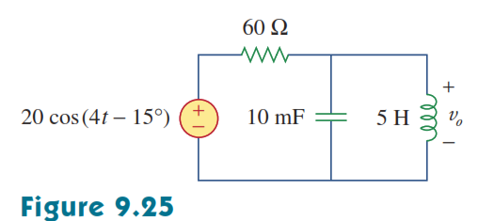
Kirchhoff’s Laws in the Frequency Domain

Slide 31
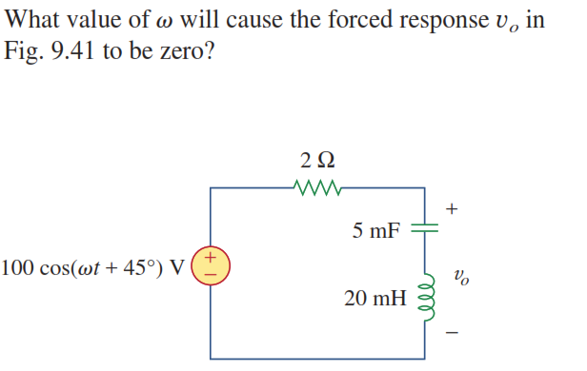
H/W

Slide 32

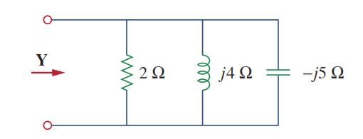
H/W

